Slide 1
Advanced Modeling for Distribution Planning with OpenDSS
Instructor
Roger C. Dugan Sr. Technical Executive Sacramento, California June 22-23, 2017

Slide 2

Instructor
Roger C. Dugan, Life Fellow, IEEE
Roger is a Sr. Technical Executive with EPRI in Knoxville, Tennessee USA. He has over 45 years of combined experience in distribution engineering with EPRI, Electrotek Concepts, and Cooper Power Systems. He holds the BSEE degree from Ohio University and the Master of Engineering in Electric Power Engineering degree from Rensselaer Polytechnic Institute, Troy, NY. Roger has worked on many diverse aspects of power engineering over his career because of his interests in applying computer methods to power system simulation. Beginning with a student internship with Columbus and Southern Ohio Electric Co, his work has been focused on Distribution Engineering. He was elected a Fellow of the IEEE for his contributions in harmonics and transients analysis. Recently, he has been very active in distributed generation, particularly as it applies to utility distribution systems and distribution system analysis. He was the 2005 recipient of the IEEE Excellence in Distribution Engineering Award. He is coauthor of Electrical Power Systems Quality published by McGraw-Hill, now in its 3rd edition. He serves on the IEEE PES Distribution System Analysis Subcommittee and is active in the Distribution Test Feeders WG.

Slide 3
Generator Model

Slide 4
Like Load, A Generator is a PC Element
General Concept
Added into Injection Current Vector
Goes into System Y Matrix
(One-Line Diagram)
Most Power Conversion (PC) Elements are Modeled Like This for power flow analysis

Slide 5
The OpenDSS Generator Model
For most power flow solutions, the GENERATOR model acts as a negative load
Differences from LOAD
Different models available
Single-mass swing model for Dynamics-mode simulations
Harmonics mode is a Voltage behind Xd’’
Originally meant to model small distortion in generator voltage
Approximations for inverter-based models (Model 7)
Follows LOADSHAPE like Load objects, but can also be dispatched
GENERATOR has a built-in energy meter (reported by ENERGYMETER object reports)

Slide 6
Generator - 3-phase Y connected
Phase 1
1
2
Phase 2
3
4 Conductors/Terminal
Phase 3
4

Slide 7
Generator - 3-phase Delta connected
Phase 1
2
1
Phase 2
3
3 Conductors/Terminal
Phase 3

Slide 8
Generator Models (Present version)
1: Injects constant P at specified PF (Default)
2: Constant admittance
3: Const P, V (Similar to conventional Pflow Generator bus)
4: Const P, Fixed Q (Q never varies).
5: Const P, Fixed Impedance Q
6: Compute P, Q from User-Written model
7: Constant P, Q, but current-limited below VminPU.
Approximates a simple inverter

Slide 9
Typical Definition
For power flow
New Generator.G1 Bus1=GenBus kW=1000 PF=1 kV=0.480
Don’t forget kV= !!
This assumes Model=1
Wind Generator PQ Model for QSTS
New "Generator.windgen1" bus1=Bg2 kv=0.48 kW=1200 conn=delta kVA=1500.000 H=6 duty=Wind2400 model=1 pf=1.000 Xdp=0.192 Xdpp=0.15
Follows Loadshape object called “Wind2400”

Slide 10
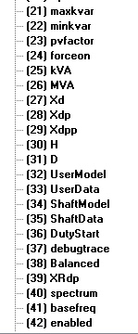
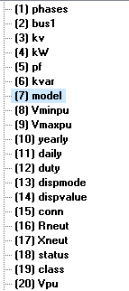
Generator Properties

Slide 11
Generator in Dynamics Mode

Slide 12
Dynamics Mode performs a basic Predictor-Corrector integration of state variables
The following three steps are performed for both the predictor and corrector steps:
Compute derivatives for this time step
Integrate state variables
Solve the circuit with this guess
The Code:
Increment_time;
{Predictor}
IterationFlag := 0;
IntegratePCStates;
SolveSnap;
{Corrector}
IterationFlag := 1;
IntegratePCStates;
SolveSnap;

Slide 13
Dynamics Model

Slide 14
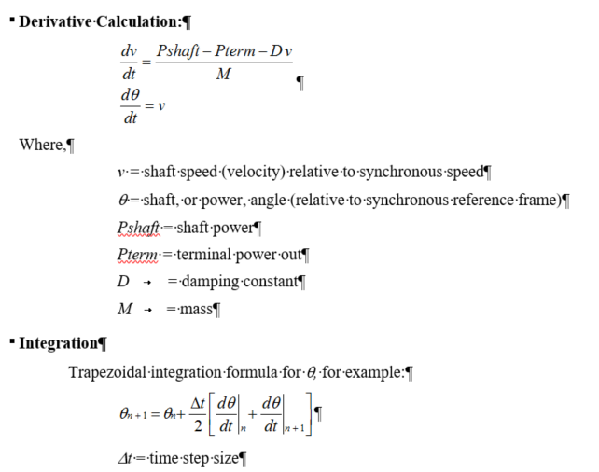
Swing Equation in Default Generator Model

Slide 15
There are No Exciter or Governor Models Built in
Shaft power and Thevenin voltage do not change for default usage
User must provide a user-written DLL, either:
“UserModel” for exciter and governor models
“ShaftModel” for advances shaft dynamics
Note: You may need to set the “XRdp” property for Generator to match short circuit calculations by other programs.

Slide 16
Example with UserModel
New "Generator.windgen1" bus1=Bg2 kv=0.48 kW=1200
~ conn=delta kVA=1500.000 H=6 duty=Wind2400
~ model=6 Xdp=0.192
~ UserModel=IndMach012a
~ UserData=(rs=0.048 xs=0.075 rr=0.018 xr=0.12 xm=3.8 option=variableslip)
(IndMach012a = name of DLL)
Note: IndMach012 is now a built-in model in OpenDSS

